Slide 2
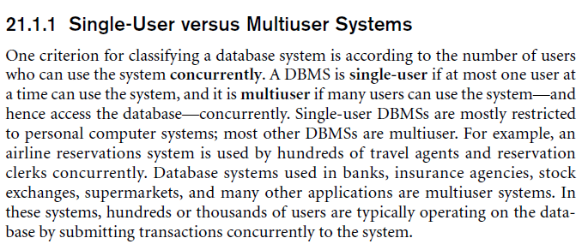

Slide 3
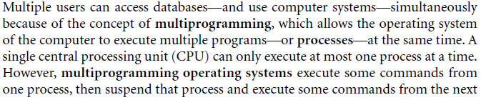
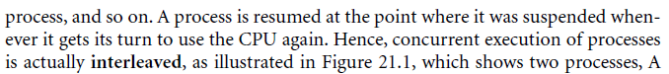
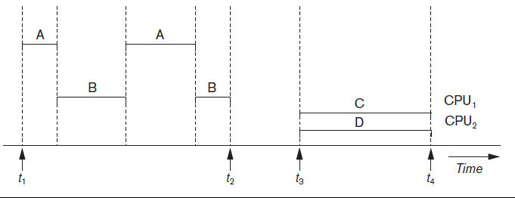

Slide 4
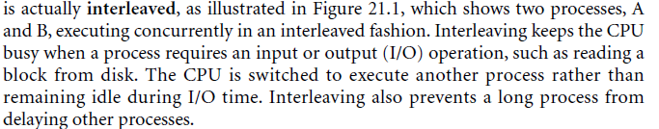
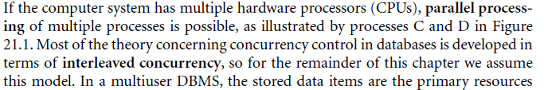

Slide 5

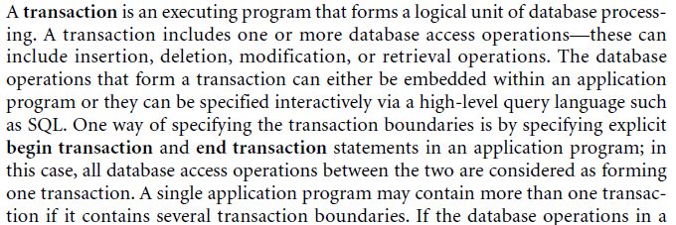

Slide 6
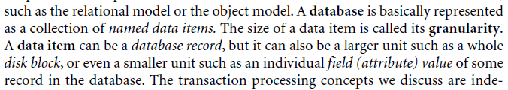
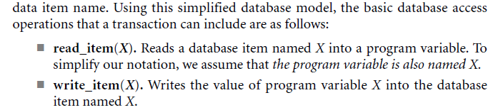

Slide 7
Introduction to Transaction Processing (4)
READ AND WRITE OPERATIONS:
Basic unit of data transfer from the disk to the computer main memory is one block. In general, a data item (what is read or written) will be the field of some record in the database, although it may be a larger unit such as a record or even a whole block.
read_item(X) command includes the following steps:
Find the address of the disk block that contains item X.
Copy that disk block into a buffer in main memory (if that disk block is not already in some main memory buffer).
Copy item X from the buffer to the program variable named X.

Slide 8
Introduction to Transaction Processing (5)
READ AND WRITE OPERATIONS (cont.):
write_item(X) command includes the following steps:
Find the address of the disk block that contains item X.
Copy that disk block into a buffer in main memory (if that disk block is not already in some main memory buffer).
Copy item X from the program variable named X into its correct location in the buffer.
Store the updated block from the buffer back to disk (either immediately or at some later point in time).

Slide 9
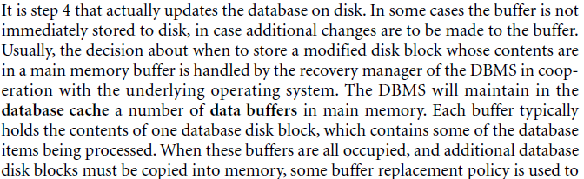

Slide 10
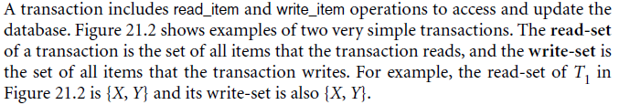
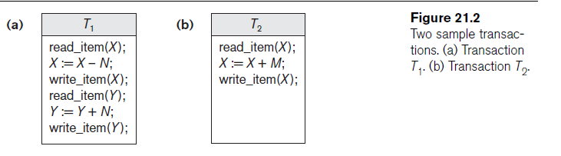

Slide 11
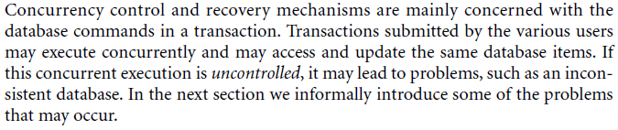

Slide 12
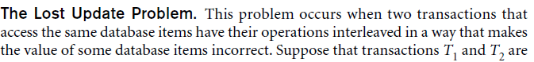
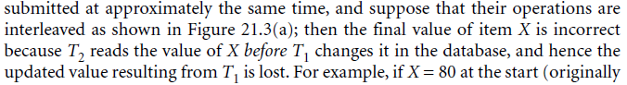
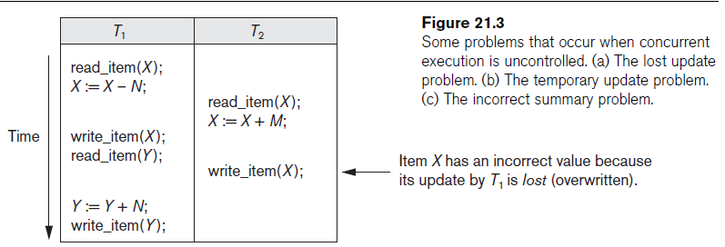

Slide 13
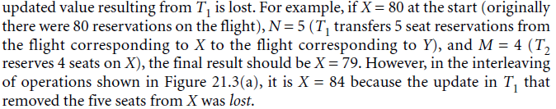
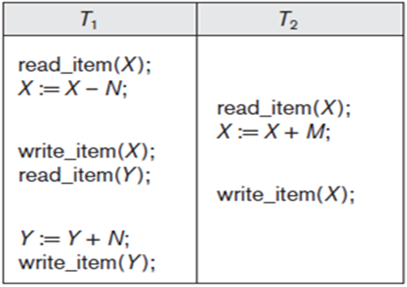

X=80 N=5 M=4
T1
T2
X=80
X= 80 - 5
X=80
Write(X)= 75
X= 80 + 4
Write(X)= 84
Final (X)= 84
Final (X)= 79

Slide 14
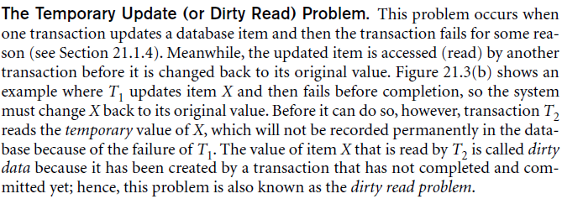
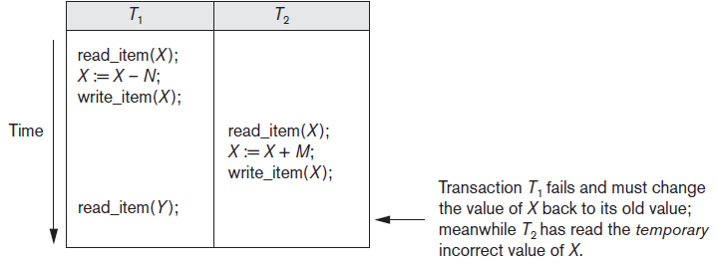

Slide 15
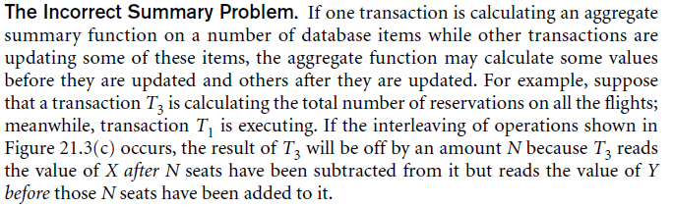
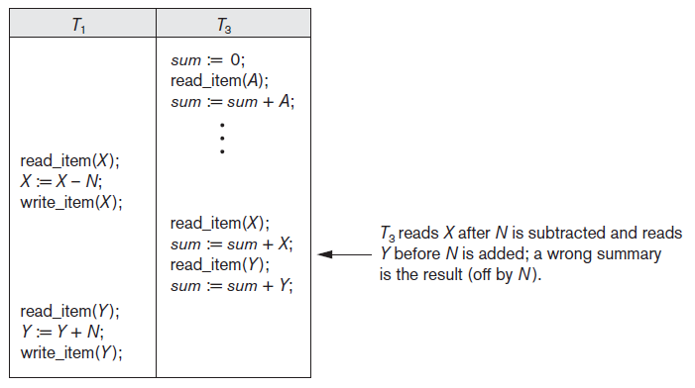

Slide 16
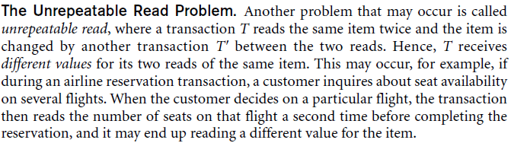

Slide 17
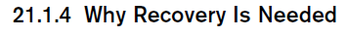
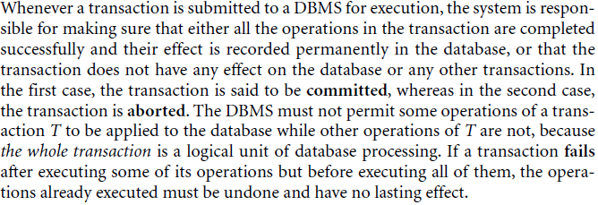

Slide 18
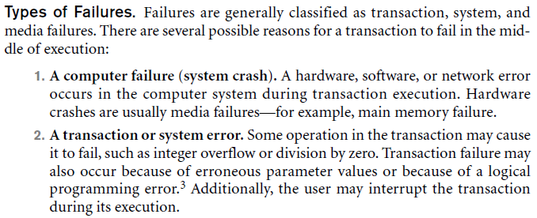

Slide 19
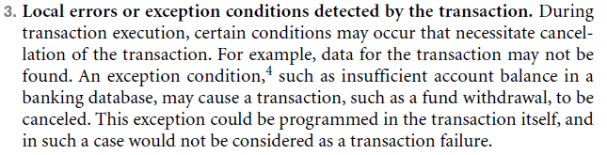

Slide 20
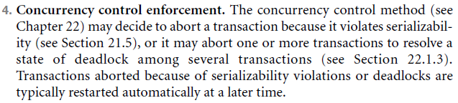
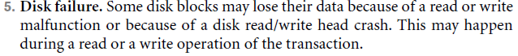

Slide 21
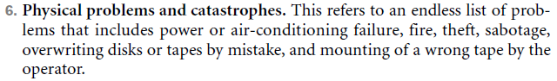
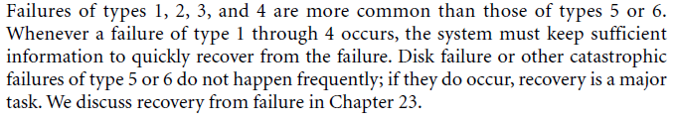

Slide 22
Transaction Processing Part 2

Slide 23
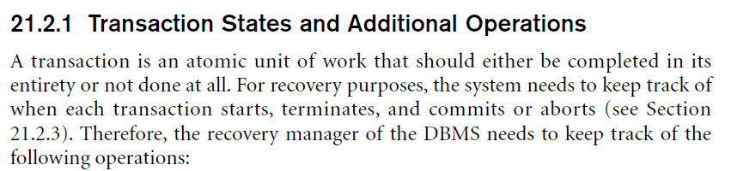

Slide 24
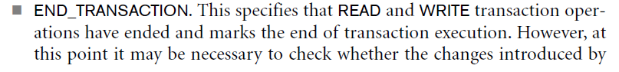
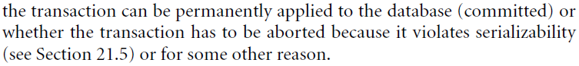

Slide 25
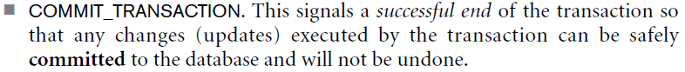
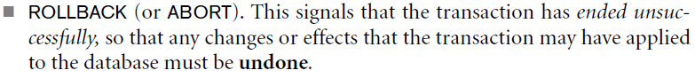

Slide 26
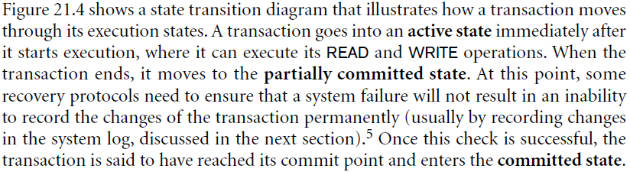
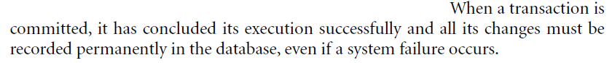

Slide 27
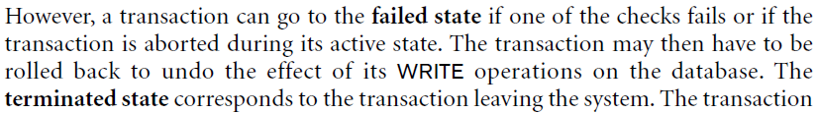
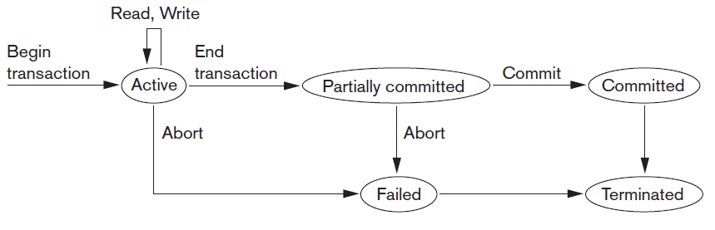

Slide 28

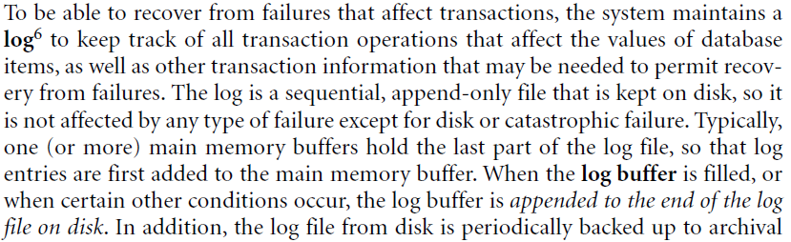

Slide 29
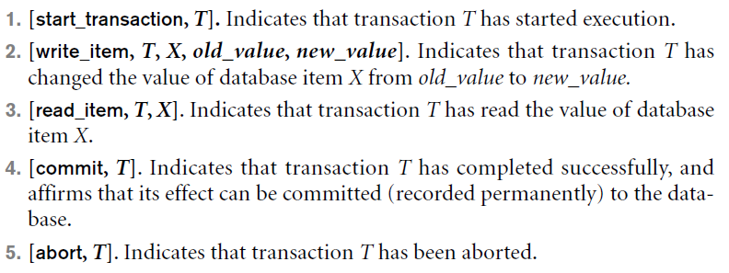

Slide 30
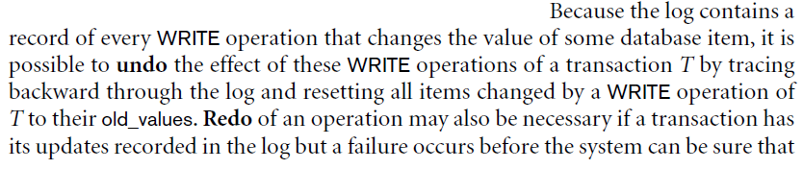

Slide 31
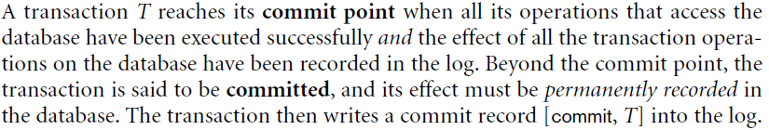

Slide 32
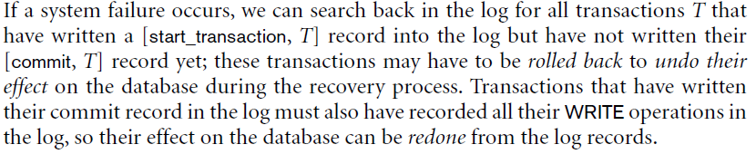

Slide 33
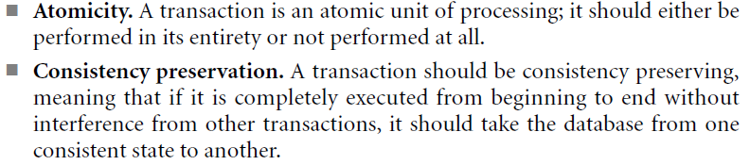

Slide 34
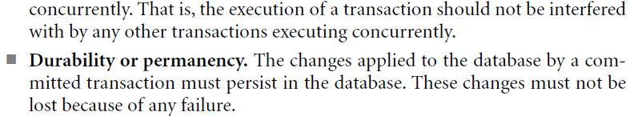

Slide 35
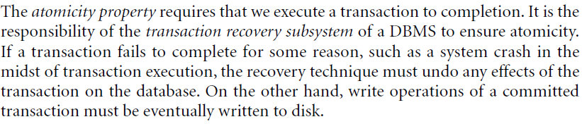

Slide 36
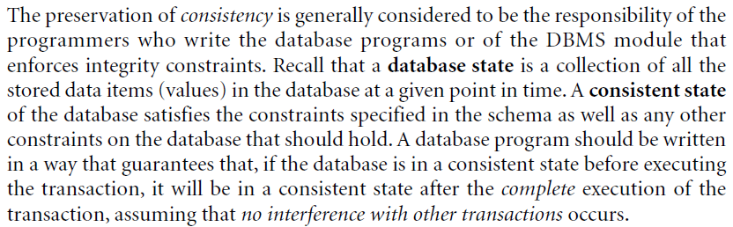

Slide 37
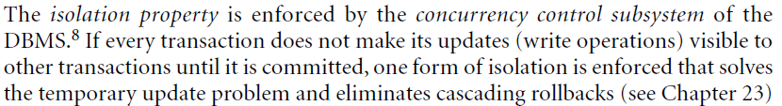

Slide 38
Transaction Processing Part 3

Slide 39



Slide 40



Slide 41



Slide 42

Conflic Operations
W2 (x) | R1(x)
W1(x) | R2(x)
W2(x) | W1(x)

Slide 43



Slide 44


Slide 45


Slide 46



Slide 47



Slide 48


Slide 49


Slide 51
Transaction Processing Part 4

Slide 52



Slide 53


Slide 54


Slide 55


Slide 56


Slide 57


Slide 58



X=100
X=100
X=500
X=500
X=110
X=100*1.1 =110
X=510
X=500*1.1 =550

Slide 59


S1
S2
T2 | T1
 | ----
-----
 | W(X)
R(X)
T2 | T1
 | W(X)
R(X)
 | ---
----
T2 | T1
 | ----
----
 | R(X)
W(X)

Slide 60



Slide 61



Conflict Serializable Shedule
Schedule D = Schedule A

Slide 62


Non Conflict Serializable Shedule

Slide 63



Slide 64


Slide 65

X
T1
T2
No Cycles ,
Serializable Shedule

Slide 66
X
T1
T2
X
Has Cycles ,
Non Serializable Shedule

Slide 67

Has Cycles ,
Non Serializable Shedule
Y
T1
T2
X
Y
Y
, Z
T3

Slide 68

No Cycles ,
Serializable Shedule
T3 →T1→T2
Y
, X
T1
T2
Y
Z
, Y
T3

Slide 69


Slide 70


Slide 71


Slide 72




Slide 73



Slide 74


Slide 75



Slide 76


Slide 77


